Slide 2
Our Active School Coordinator: Mrs. Quill

Slide 3
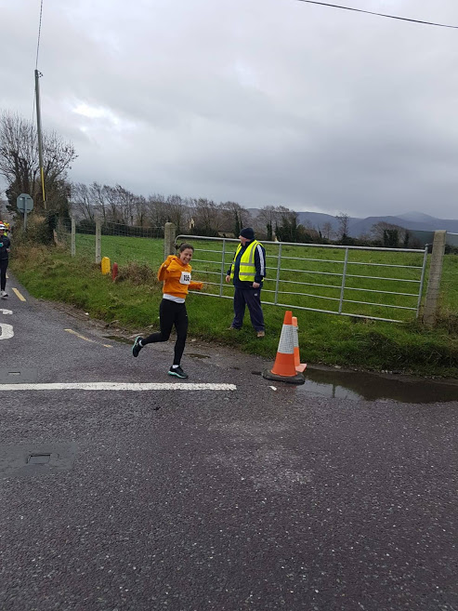
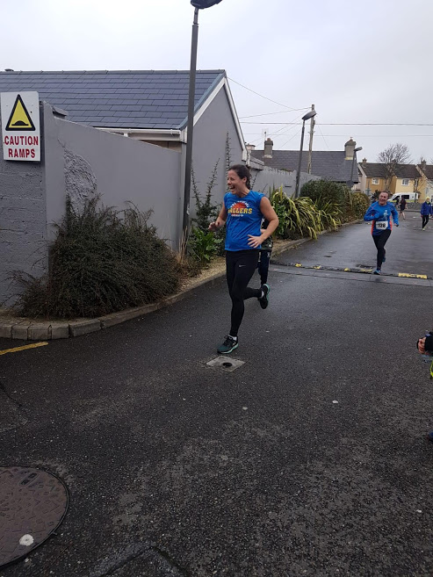
Running a 10k
Just for
fun

Slide 4
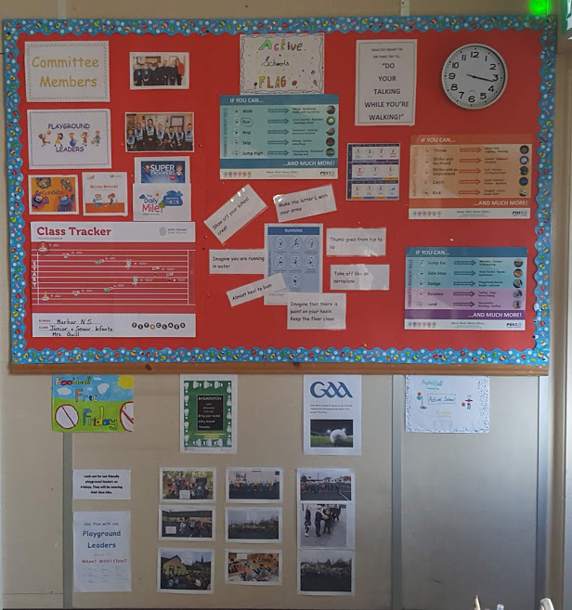

Slide 5
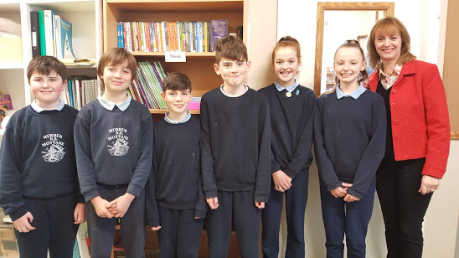
Our A.S.F. Committee

Slide 6
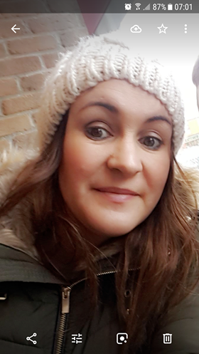
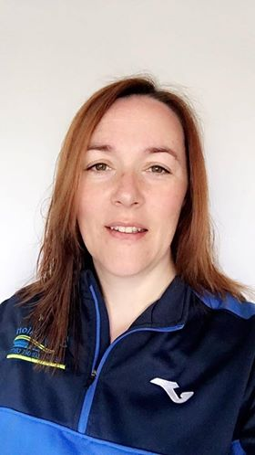
Our Parental Involvement -
Some of our parents also come to our Daily Mile Running Initiative.

Slide 7
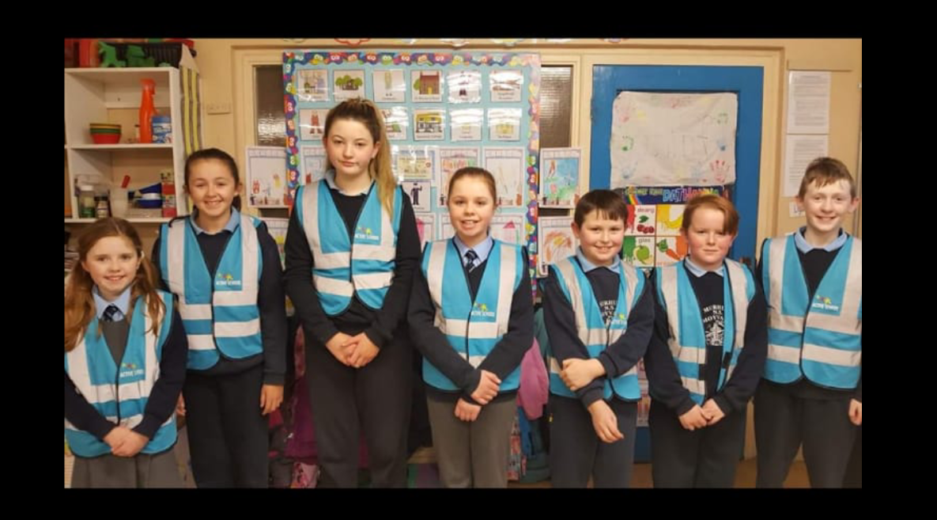
Our Playground Leaders

Slide 8
Physical Education
Mrs. Quill went to the “Move Well Move Often” P.D.S.T. training day in the Kerry G.A.A. Centre of Excellence in Currans on the 27th of February.
She reported back to the staff during our Croke Park meeting for an hour.
The chosen fundamental skill was “Running” from the Locomotor Skills section as it was noted that some children at The Daily Mile time are not presenting with good knowledge or ability of these skills esp. posture.
Each teacher concentrated on these 7 teaching points within “Running” from the PDST website and the Move Well Move Often Teacher Manual in class and the children assessed each other.

Slide 9
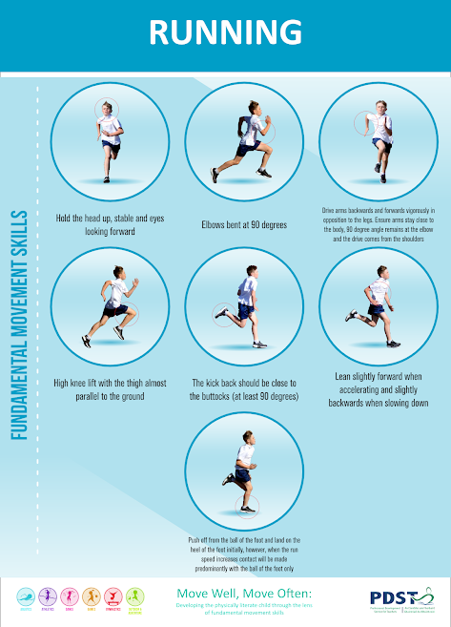

Slide 10
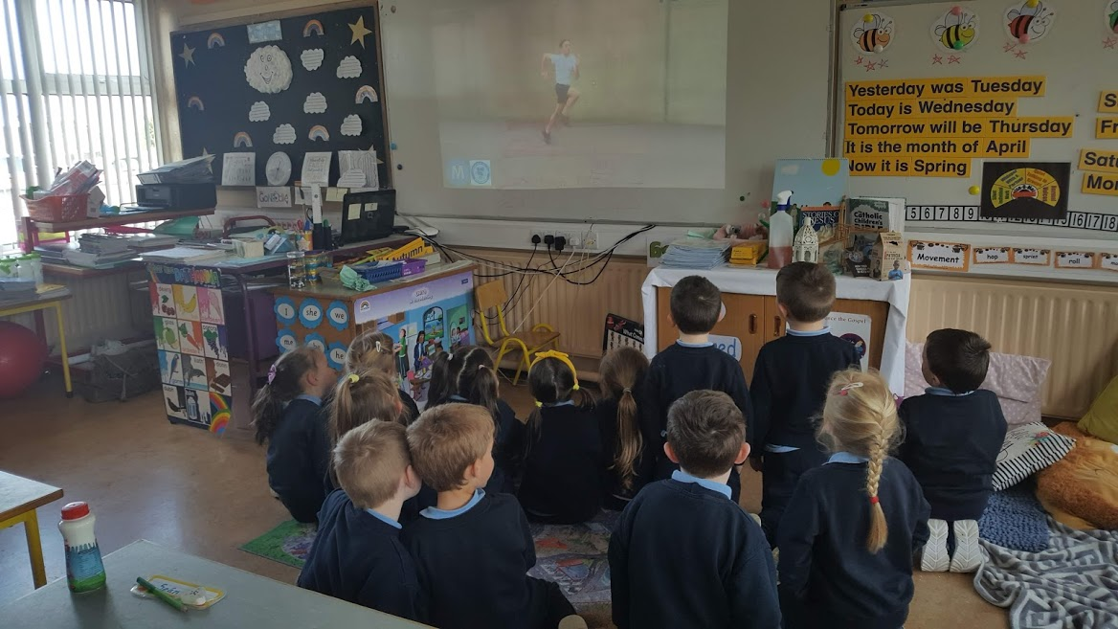
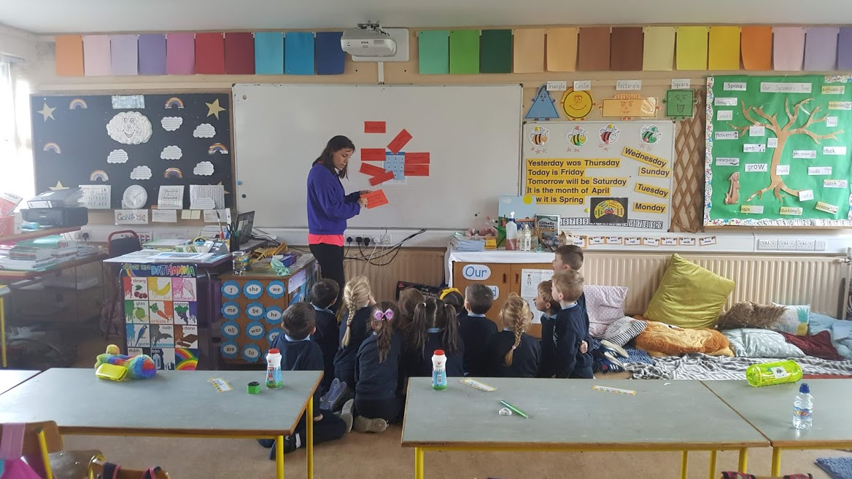

Slide 11
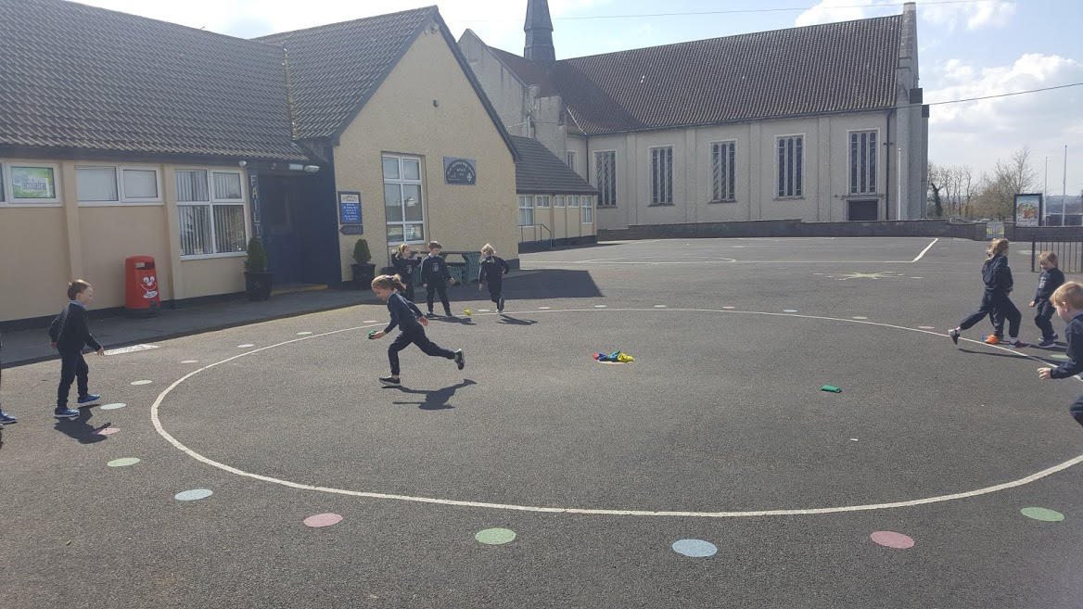
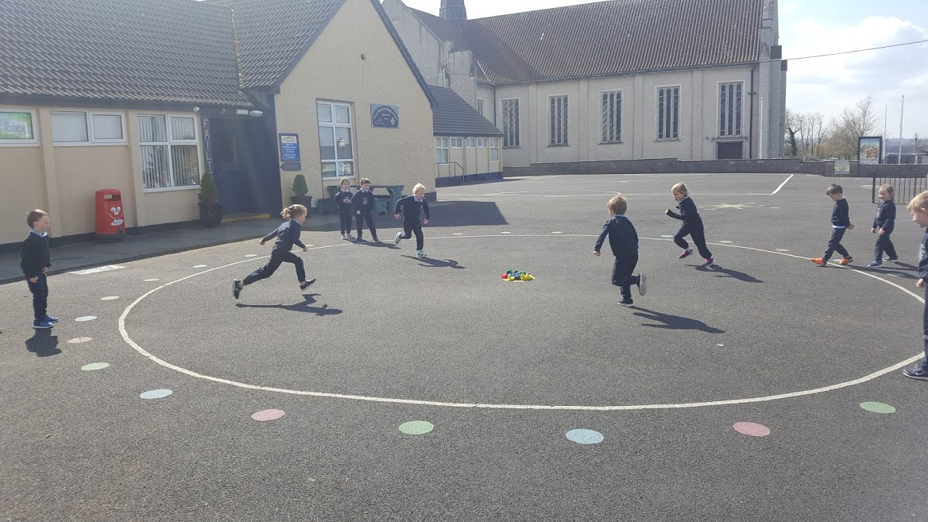

Slide 12
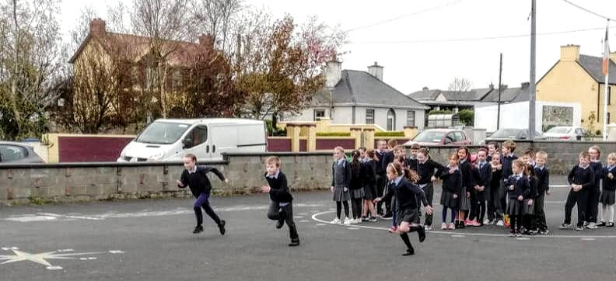

Slide 13
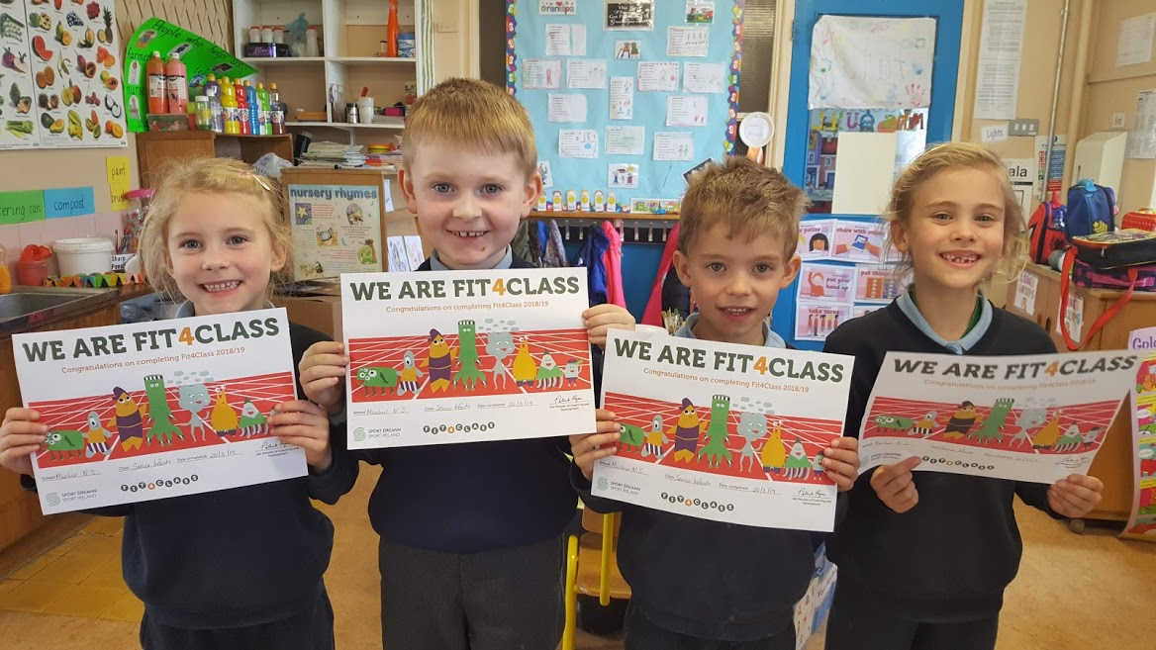
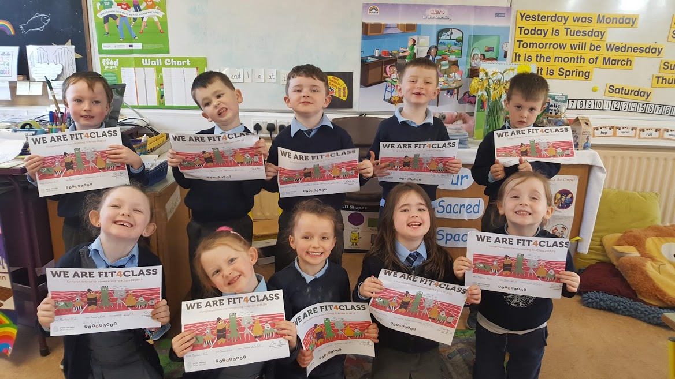
Athletics:
We have completed Fit4Class, a great programme which encorporates all aspects of the strand athletics: running, jumping and throwing.

Slide 14
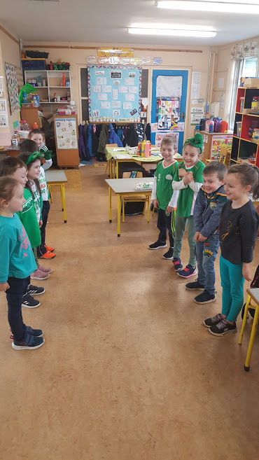
Agus ....
ag rince chomh maith:
Ceithre os ceithre.....

Slide 15
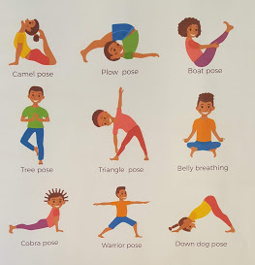
Yoga as part of Gymnastics –
Balance .

Slide 16
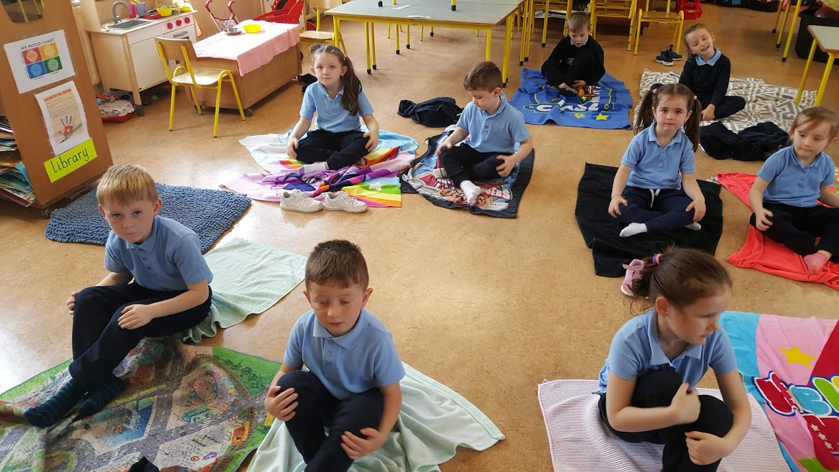
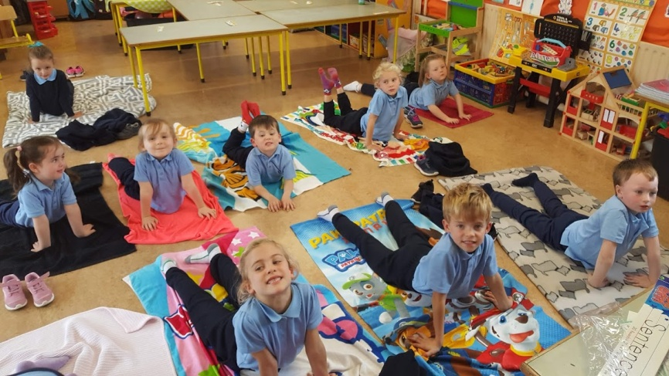
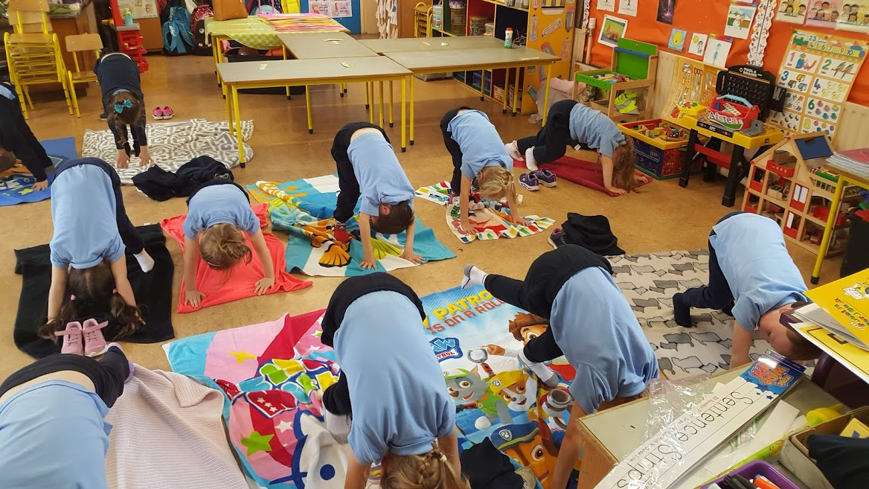

Slide 17
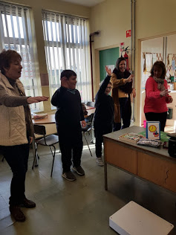
O.T. And Movement Breaks

Slide 18
Physical Activity
We undertook a lot of extra physical activity throughout this year.
Festive Activities
Running Initiatives
Bizzie Breaks and Go Noodle on wet days.
Playground Activities with playground leaders.
Nature Walks and Treasure Hunts

Slide 19
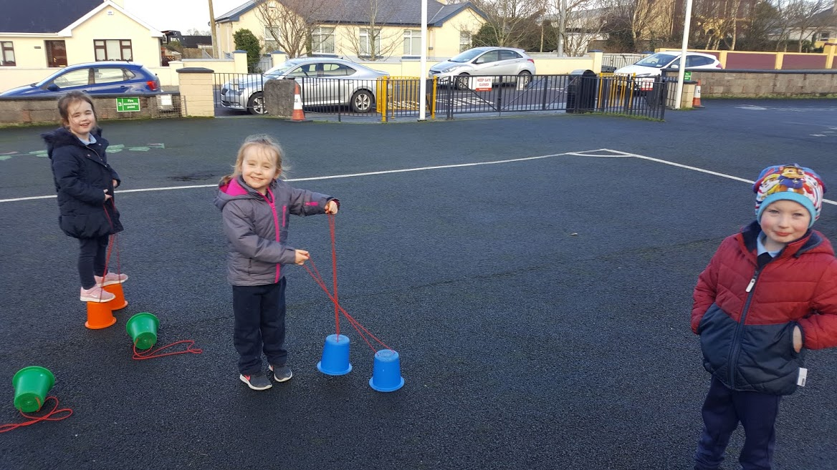
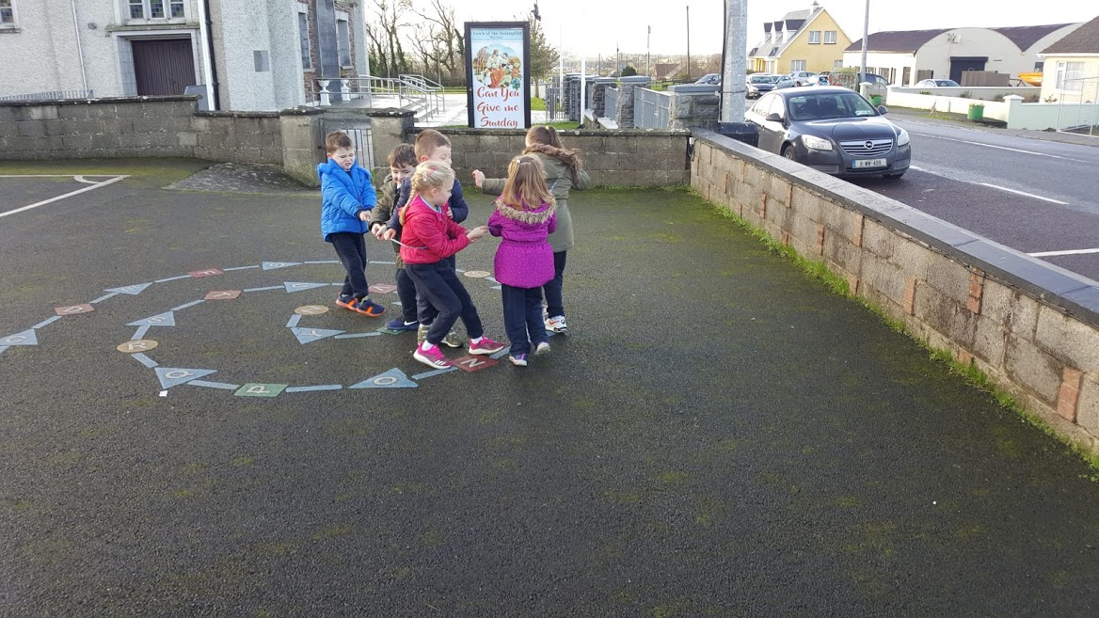
At yard time we use equipment to have fun and the yard markings.

Slide 20
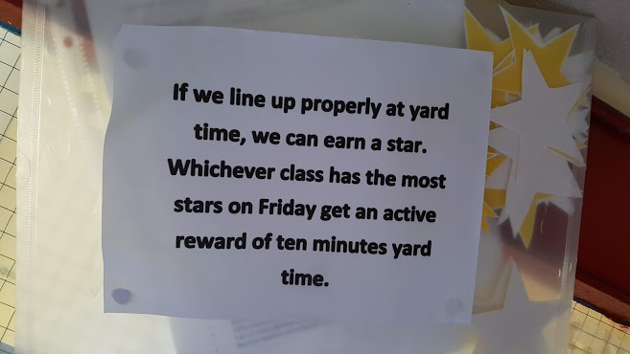
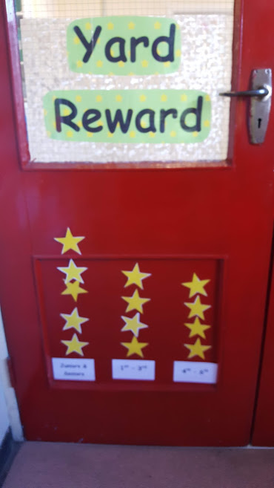
We use positive active rewards for good behaviour.

Slide 21
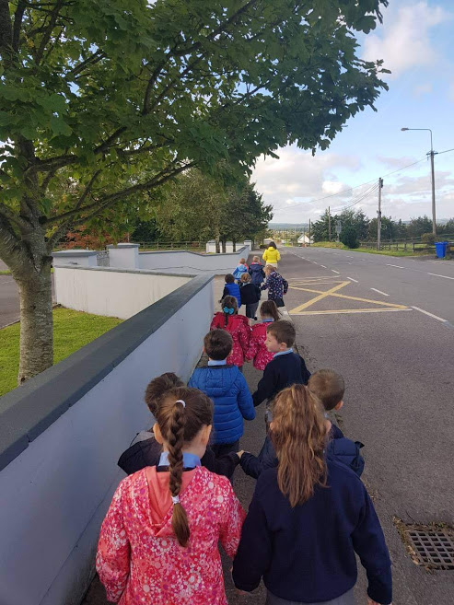
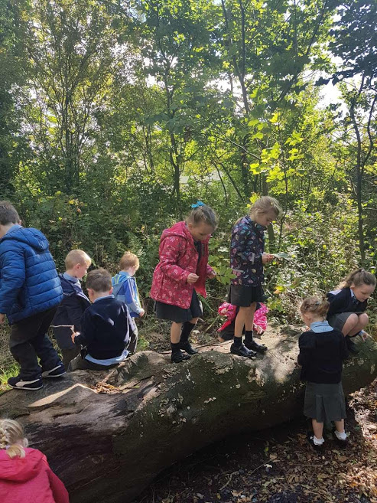
Autumn Treasure Hunt

Slide 22
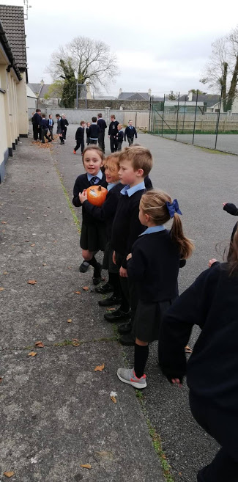
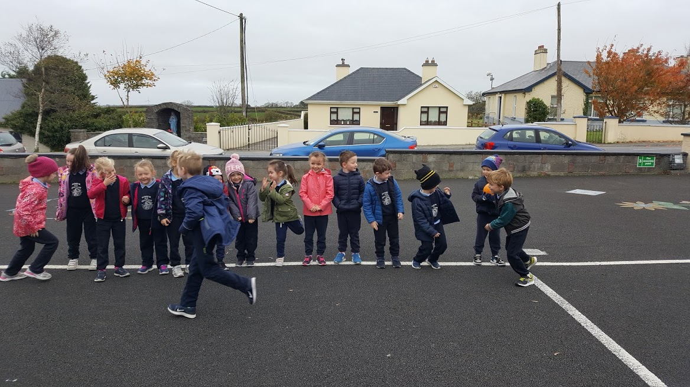
Pumpkin Pass

Slide 23
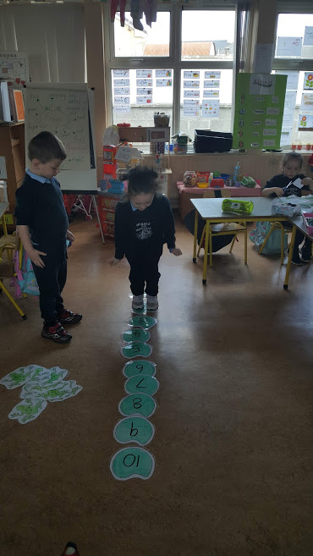
Active
learning
through
Aistear

Slide 25
The Haunted Hop

Slide 26
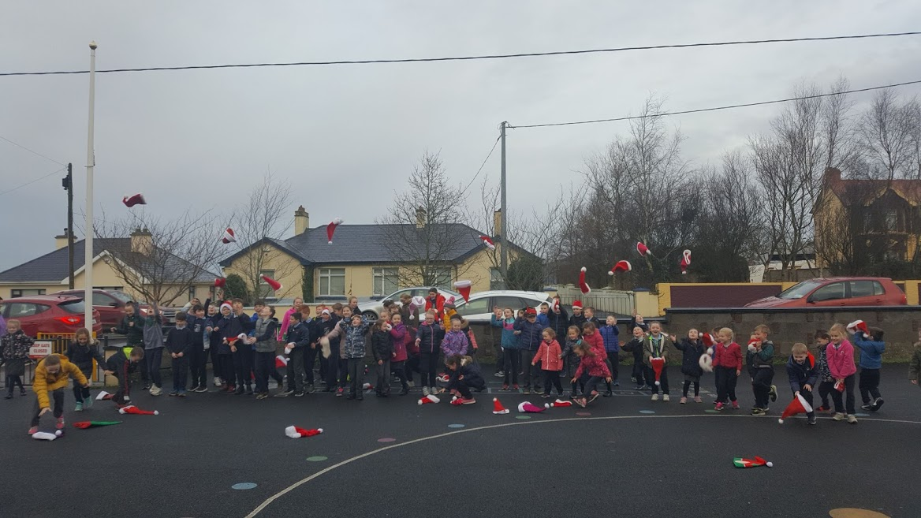
Our Santa Sprint

Slide 27
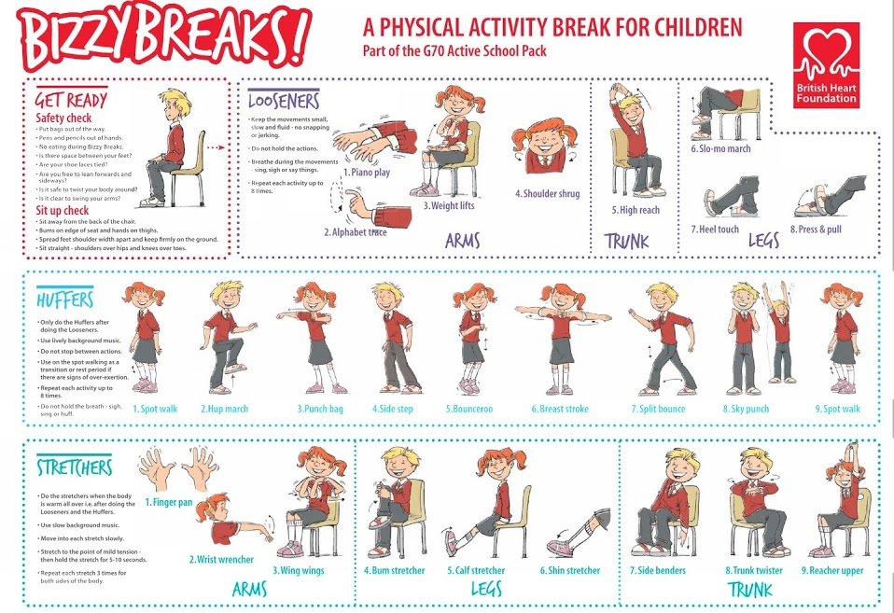

Slide 28
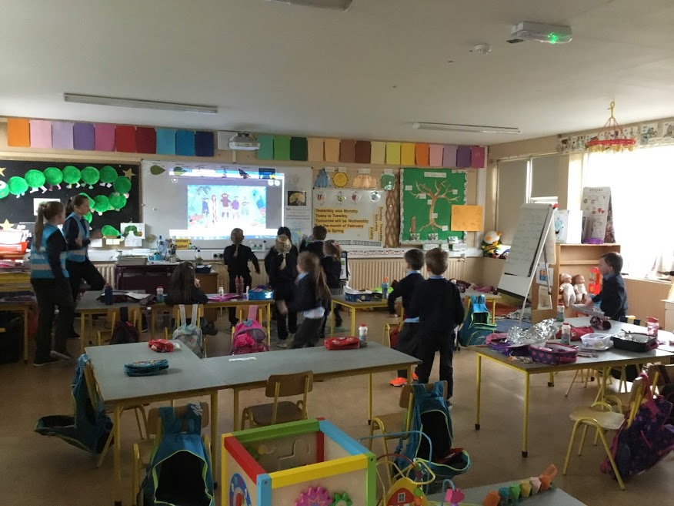
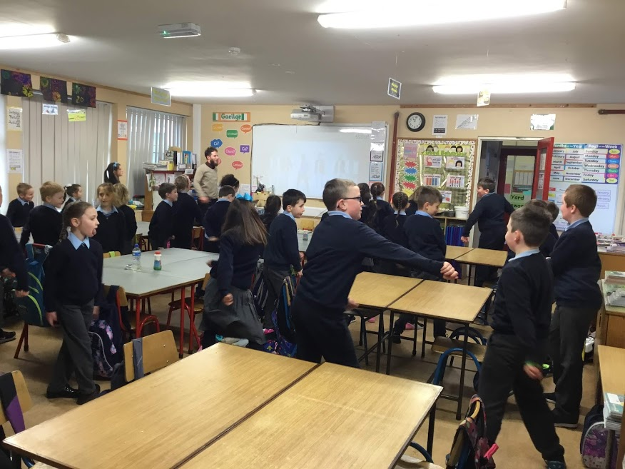
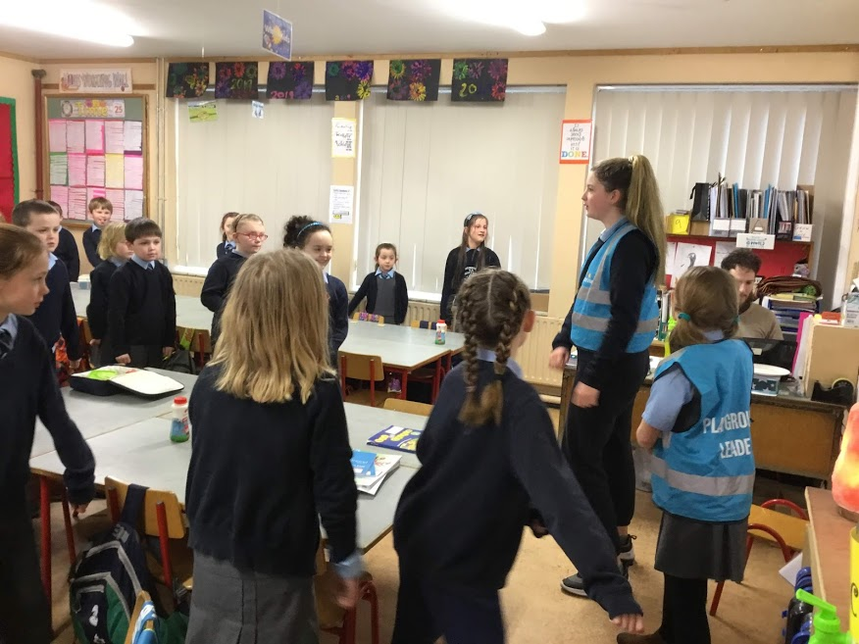

Slide 29
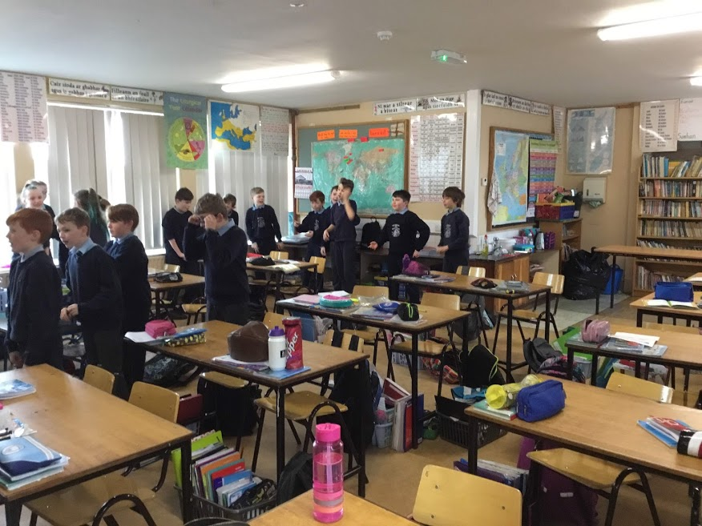
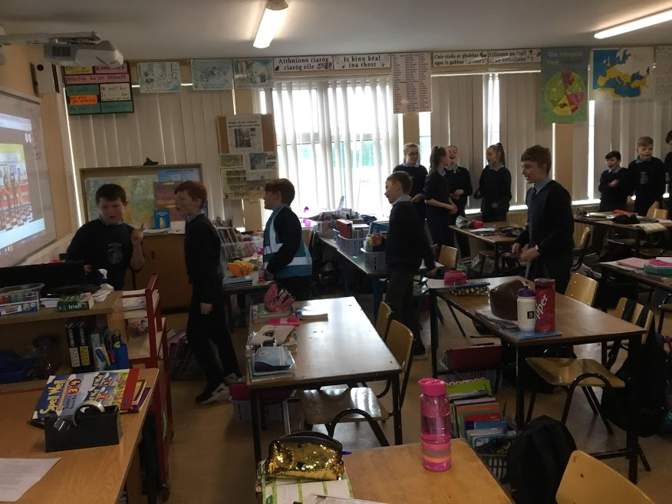

Slide 31
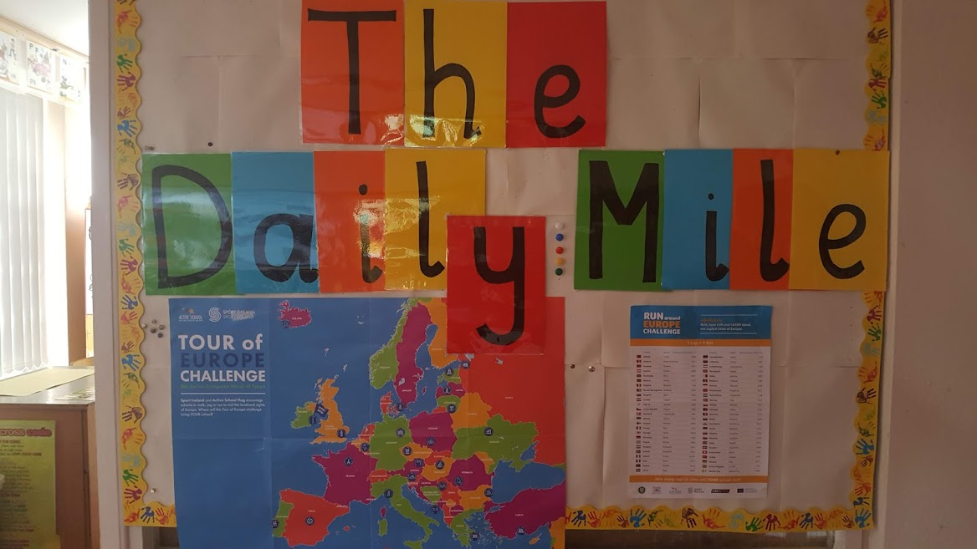
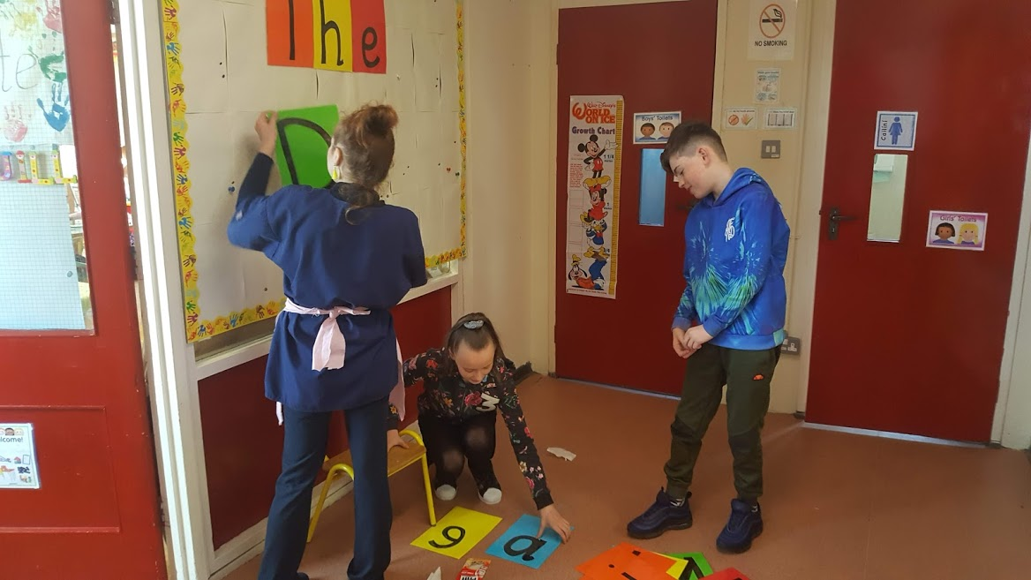

Slide 32
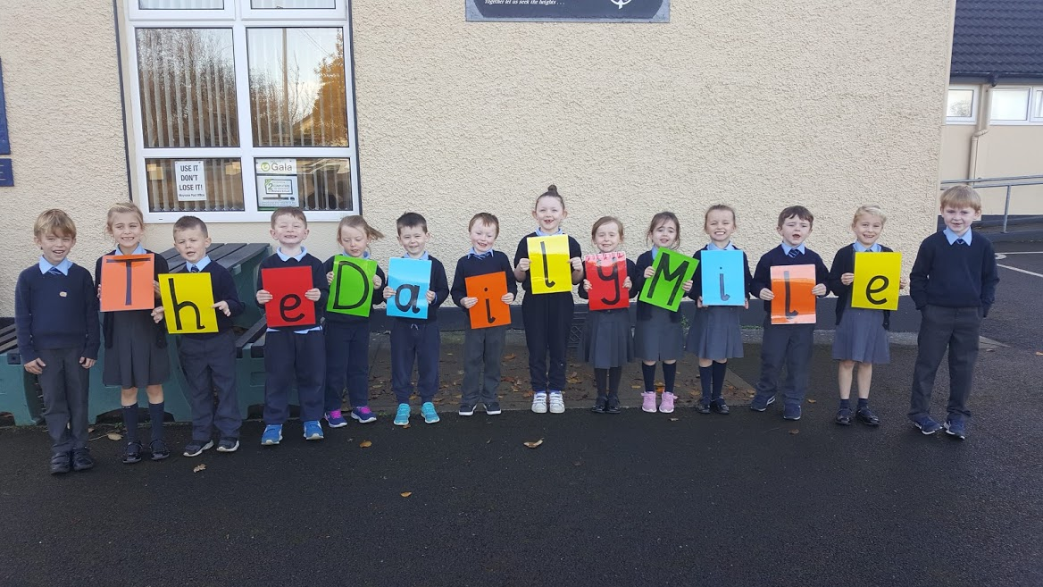
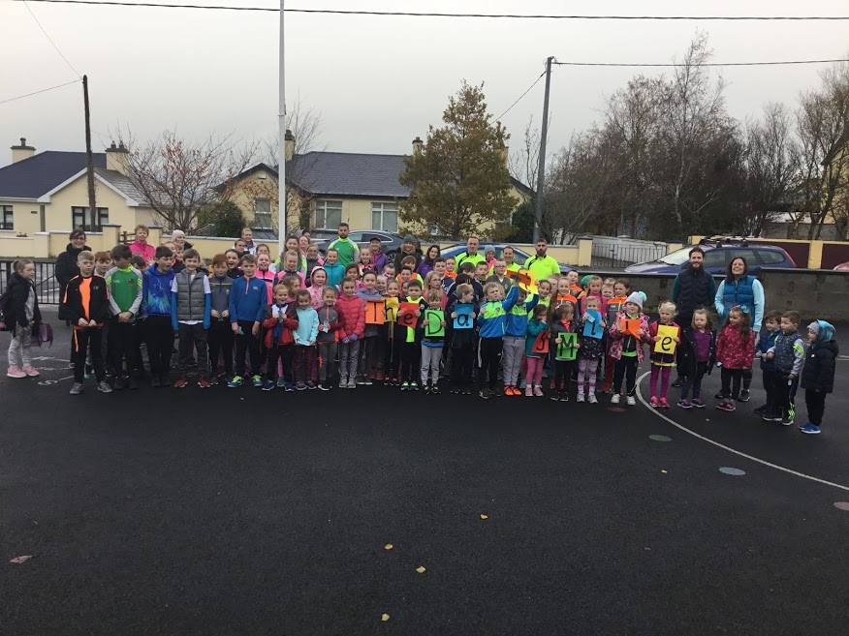
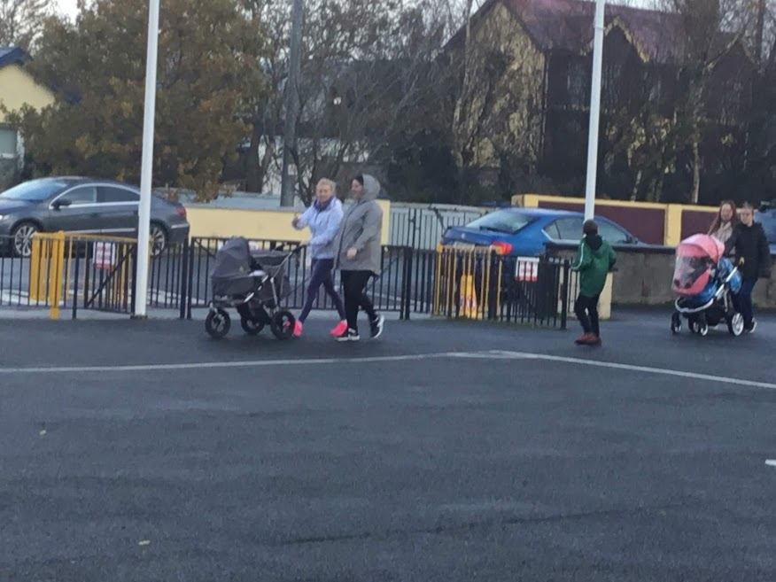

Slide 33
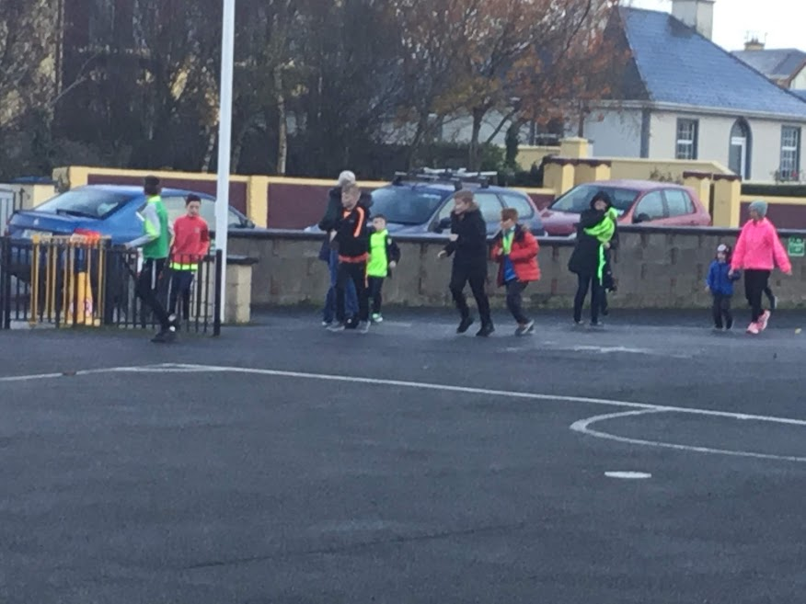
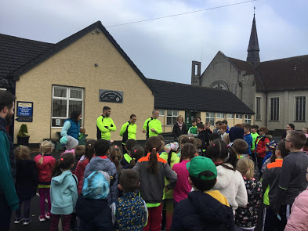

Slide 34
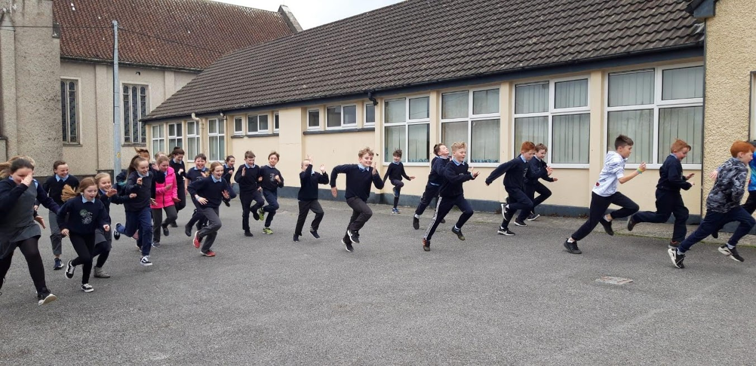
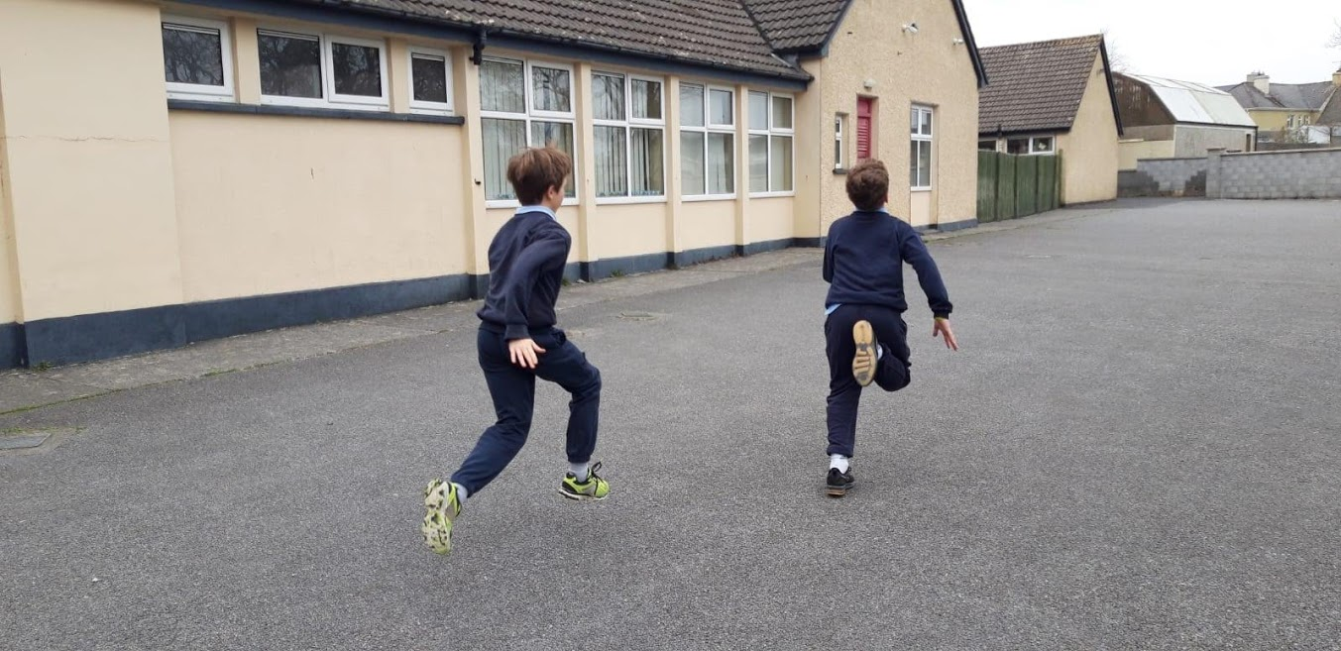

Slide 35
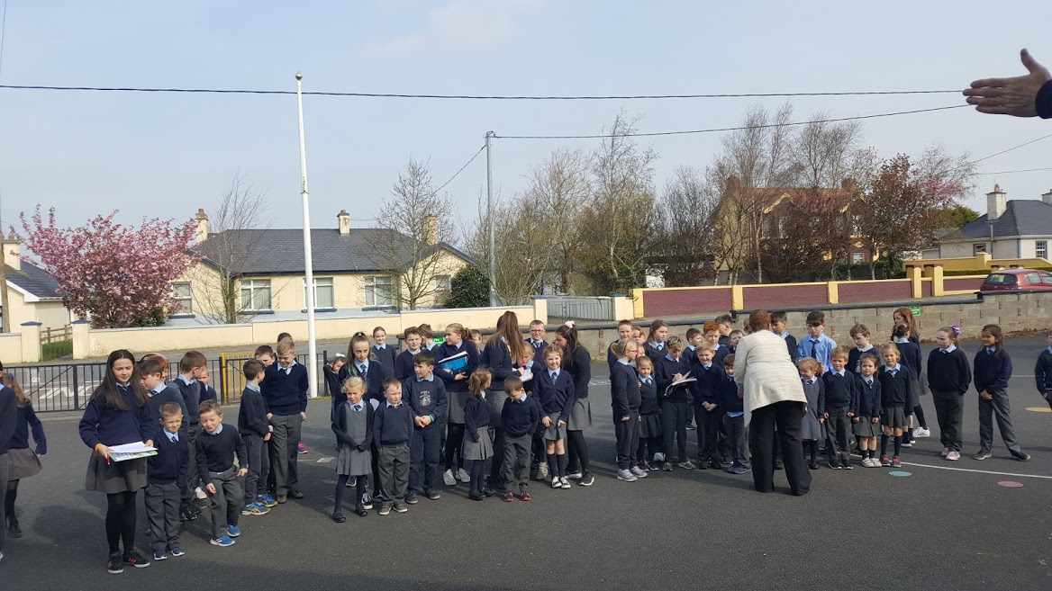
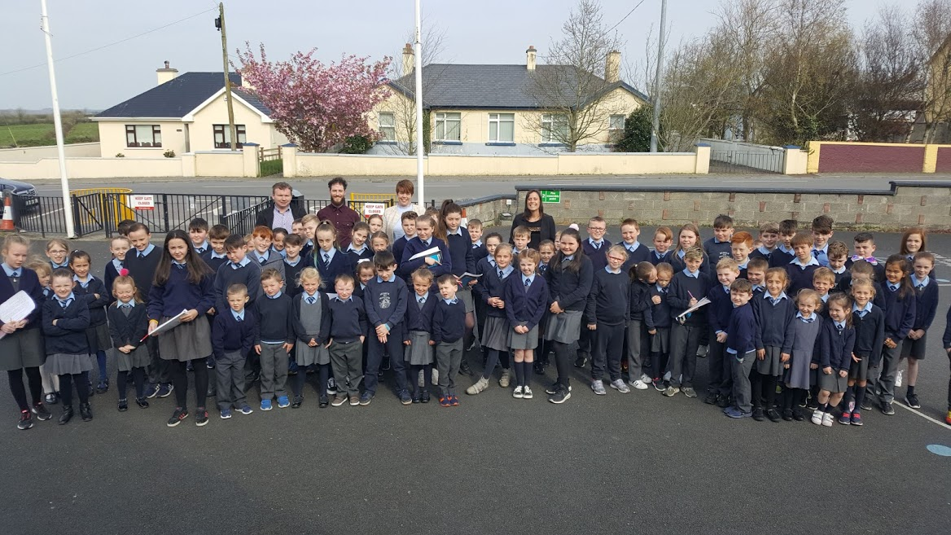
Easter Egg Orienteering

Slide 36
Partnerships
Moyvane G.A.A. Club
Moyvane Badminton Club
Park Run Listowel
Crusaders Running Club
Ballybunion Health and Leisure Centre
Streamside Stables
Cumann na mBunscol
P.A.W.S.

Slide 37
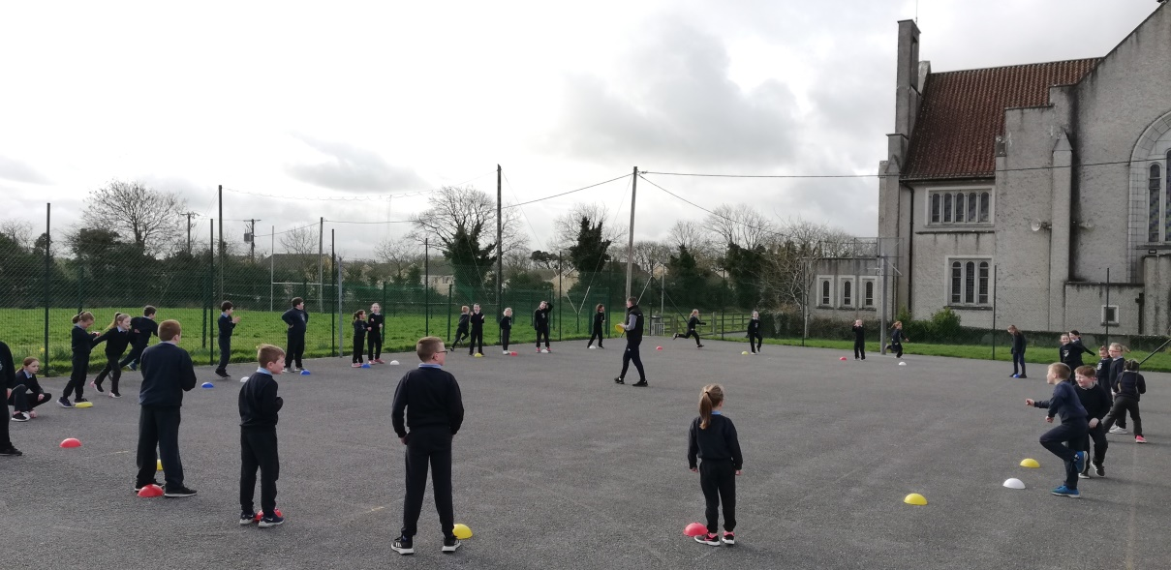
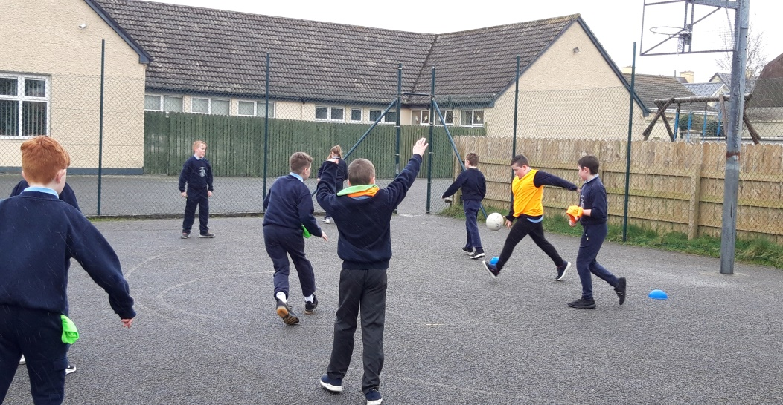
Football every second Thursday with John Barry
(John Dillion)

Slide 40
We are delighted with our School Walkway too. It goes from our school, down the road, in through the village, around by the playground and back to the school. Our community are really enjoying it also.

Slide 42
Badminton every second Thursday with Brian Kiely.

Slide 44
What Clubs Are You In?
Survey Results completed by our A.S.C.–
Moyvane Badminton
Moyvane G.A.A.
Athea and Duagh Basketball Clubs
Killeany Soccer Club
Irish Dancing
Ballybunion Swimming Club
Listowel Athletics
Tae Kwan Do Listowel
Listowel Rugby Club
Ballyduff Boxing Club
Ballyduff HurlingClub
Abbeyfeale Kick Boxing Club

Slide 45
Making use of our local amenities......

Slide 46
10th – 14th of June

